Slide 1
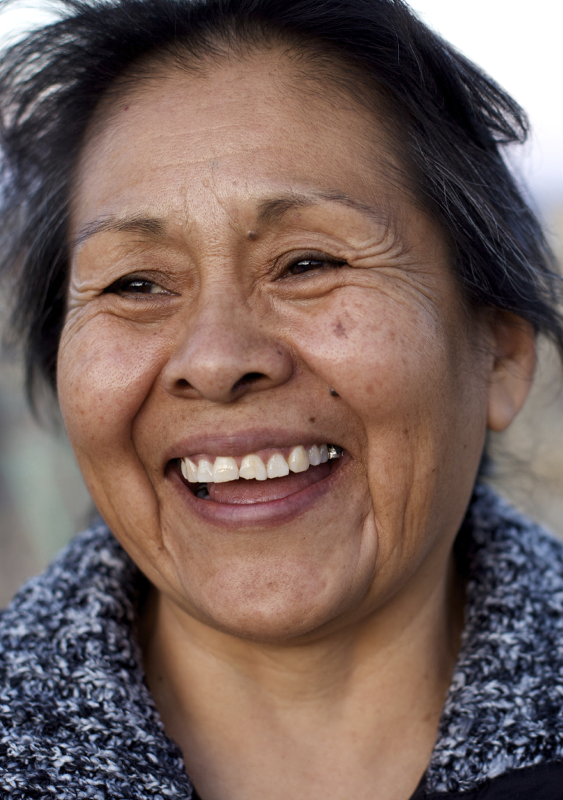

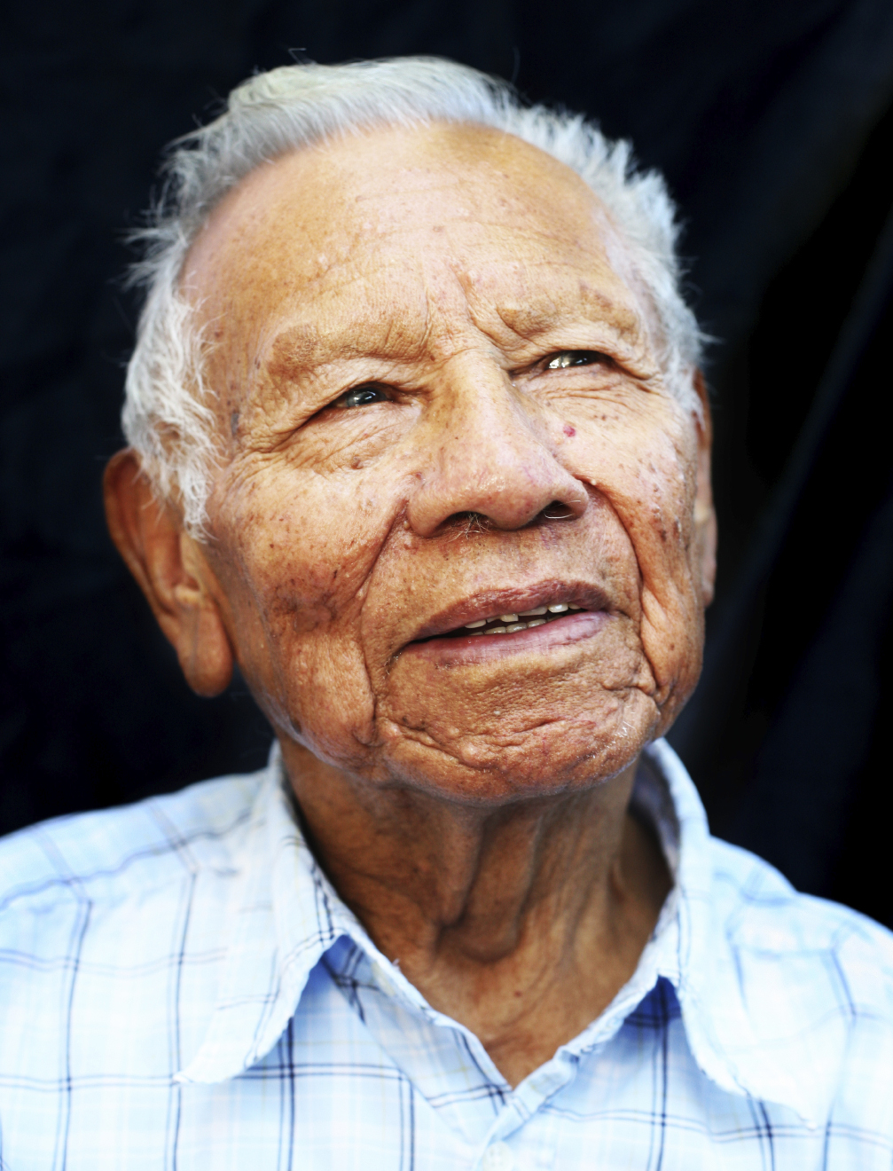
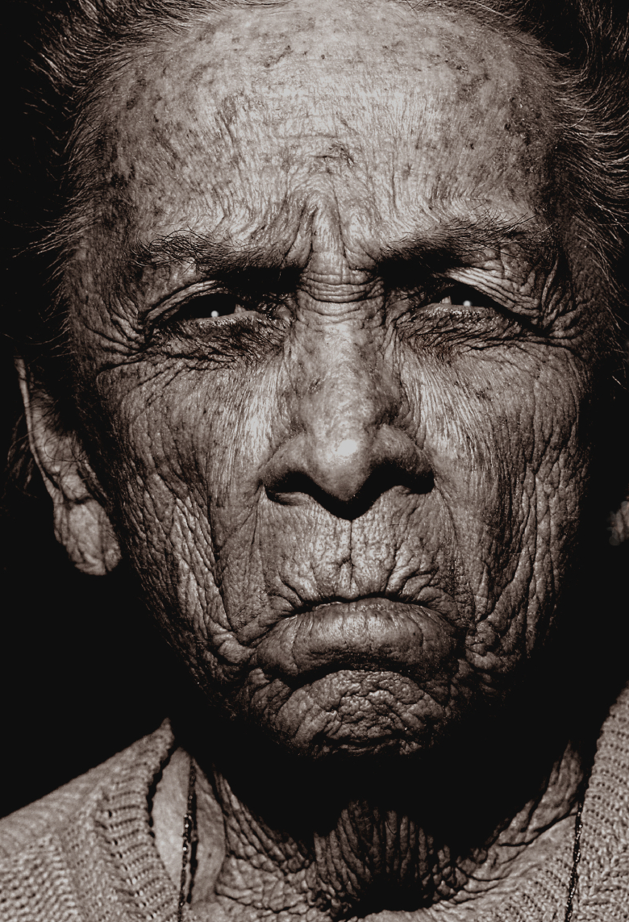


Slide 2
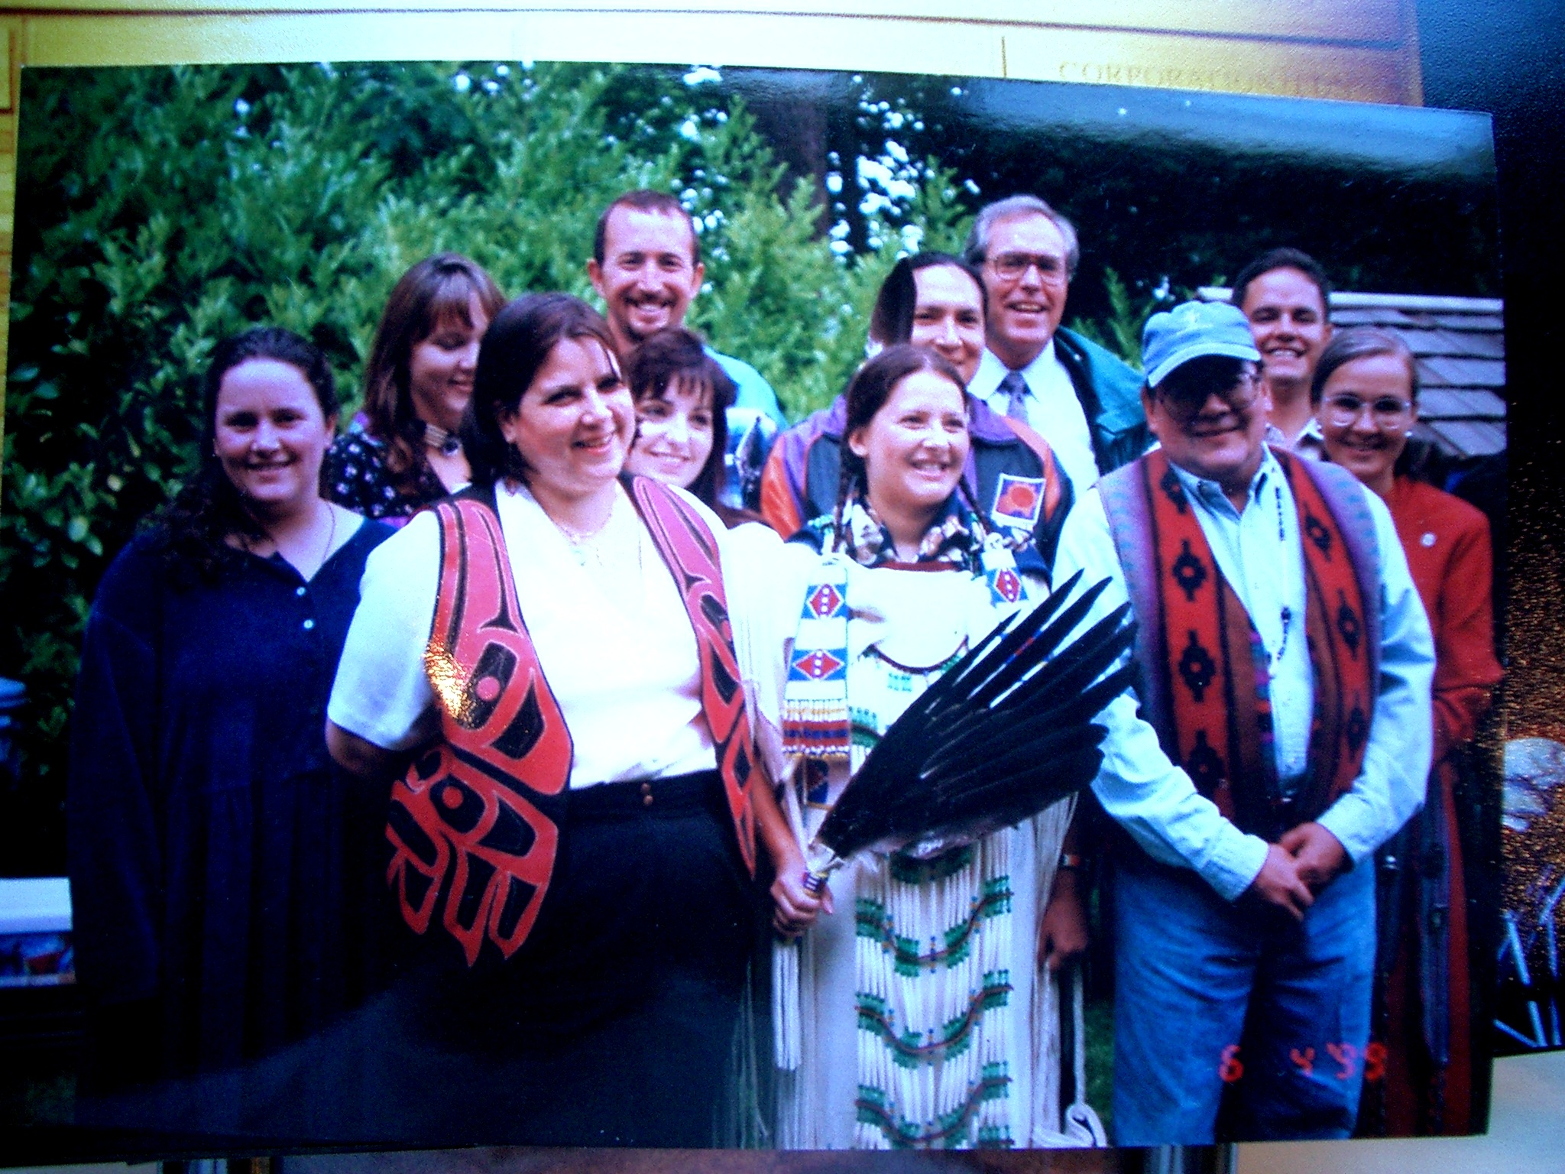
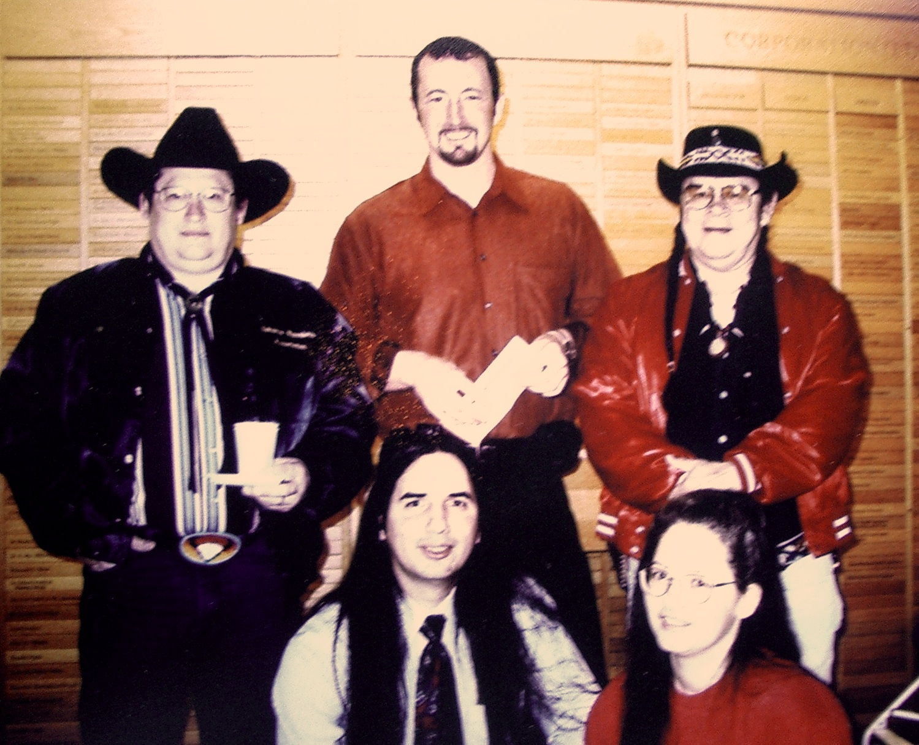

Slide 3



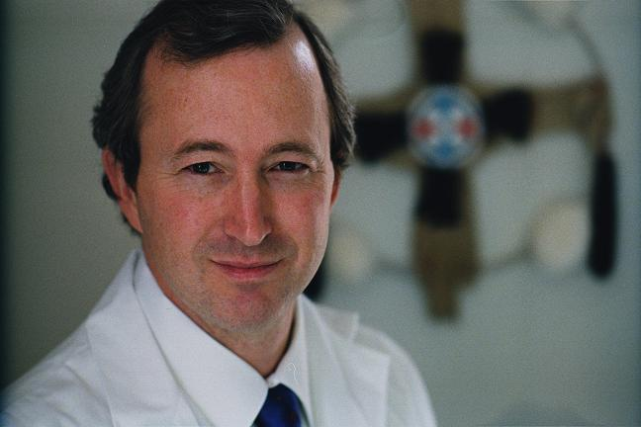
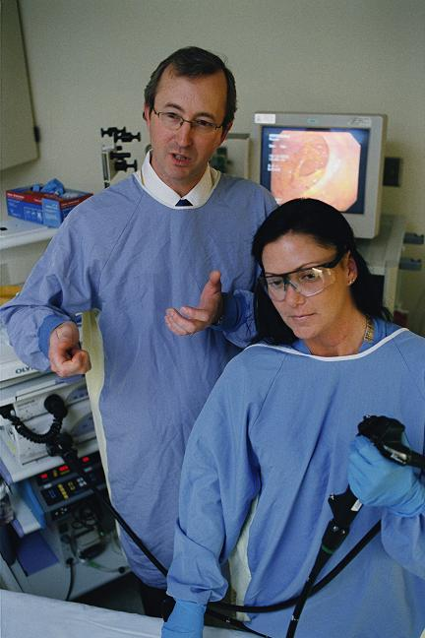
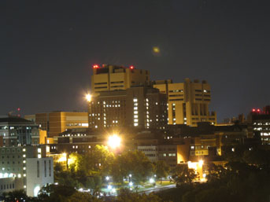

Slide 4
Cancer is the Leading Cause of Death Among Alaska Natives and Northern Plains Tribes
Mortality data for years 2004-2007; Source: NCHS; Alaska Native Tumor Registry, 2010
Notes:
Cancer is the leading cause of death in Alaska Native as well as in native people of the Northern Plains

Slide 5
Cancer Will Soon Pass Heart Disease in All American Indian populations
Mortality data for years 2004-2007; Source: NCHS; Alaska Native Tumor Registry, 2010
Notes:
Cancer will soon be the leading cause of death in the Native population as a whole
The reasons for this transition is that while treatement for heart disease—drug eluding stents, and better cholesterol and blood pressure control are reducing heart disease mortality,
Cancer mortality rates from many cancers in Native people are stagnant

Slide 6
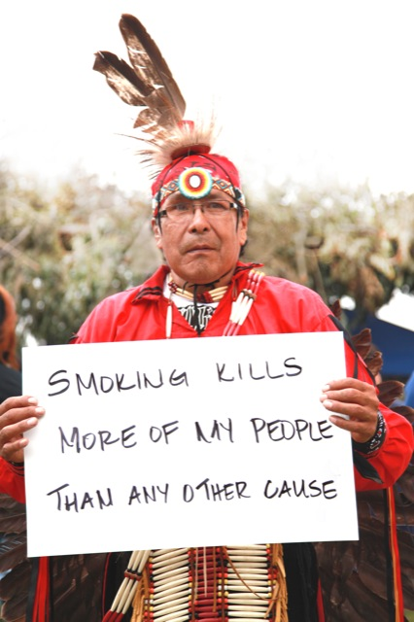
Leading Causes of Cancer Death In Indians and Alaska Natives, 1999-2006
Native Men and Women
Rank Percent
Lung 26%
Colon 10%
Breast 7%
Pancreas 5%
Liver 4%
TOTAL DEATHS 17,538
CDC, 2008
Notes:
Between 1999 and 2006, over 17000 native men, women and children died from cancer
Only 13 US tribes have tribal enrollments over 17000

Slide 7
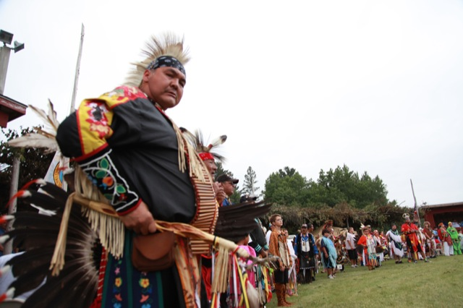
Along Comes a Spider: Cancer Inequities in Indian Country
Notes:
Today we are going to talk our about the cancer epidemic so many of us are seening in our communties

Slide 8
Objectives
Review AI/AN Cancer Inequities
Explore Risk Factors
Identify Solutions
Overview AICAF and its approach
Notes:
We will review…..

Slide 9
Steps To Eliminate Cancer Disparities
1) Understand and Earn the Trust of the Community
2) Attain Good Data
3) Base Work on the Health Belief Model
Best derived with the population’s participation
Understand the barriers
4) Use model to identify interventions
5) Help the community to help themselves
6) Listen to the elders and think outside the academic box!
Notes:
To frame the presentation I think it is good to first identify the critical steps in taking on cancer disparities, or any other health disaparity
First, as has been a strong theme of this confernce, we must understand and earn the trust of the community or communities we are engaging.
We must understand the culture, and acknowledge our responsibilty to protect the cultural fabric of those we are hoping to help
I will return to this later
Second, it is critical to attain good data so we can know where we are starting from, and measure our success. We have to keep in mind that not all changes lead to improvement
Next, it is critical to base our work on a health belief model that is tailored to the communtiy we are working with. Just because it applies to Navajo does not mean it will apply to Pine Ridge
That’s the prework and a critical component for doing success community based research]
Next we use that model and community input to tailor interventions aimed at helping the community help itself
Lastly, its always grat to think outside the box,

Slide 10
Cancer Data Is Problematic
Numerators come from medical and death records
Denominators come from census data (self-report)
Usual result is an underestimate of incidence and mortality data for AIAN
Notes:
Cancer data for native people is problematic..

Slide 11
Cancer Data Problems
Numerator Problems
Racial misclassification in medical charts affects cancer registries and incidence data
Racial misclassification on death certificates affects mortality estimates
Degree of misclassification varies widely
Denominator Problems
Allowed more than one race on 2000 Census
Notes:
When we calculate incidence and mortality rates, we have numerators and demominators
Unfotunately racial misclassification is very common in medical ecords and death certificates, and varies widely
Denominators are also a problem due to the fact that census data allows more than one race code

Slide 12
Racial Misclassification on Death Certificates
The National Longitudinal Mortality Study (Elisabeth Arias et al)
Linkage study to assess racial misclassification
Deaths Occurring between 1979-1998 (~252,000)
Data Sources
Current Population Surveys (CPS)
1980 Census Data
National Death Index
National Center for Health Statistics Mortality Data
Notes:
How big a problem is misclasifcation?
A study done several years ago by Elisabeth Arias at the national Center for health statistics linked race on death certificates to what people self reported on census data when they were alive

Slide 13
Urban and Rural AIAN Misclassification Self-Reported Race/Death Certificate Race
Urban AIAN were classified as another race 56% of the time
Rural AIAN misclassified 16% of the time
CDC Division of Vital Statistics
Notes:
They found that urban AI/Ans were classified as a race other then Indian or alaska native 56% of the time, while rural indians (ie many of those on reservations) where still misclassified 16% of the time.

Slide 14
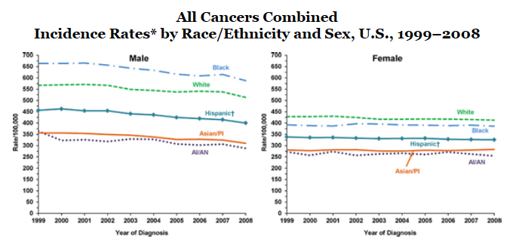
Summary Data is Problematic
Summary data misses critical difference in cancer rates between geographic areas
Centers for Disease Control Website
Notes:
Summary data is also problematic
This is hard to see I know but it is shows combined cancer rates for men and women by race.
AI/Ans are at the bottom….great…lets go home
Unfortuntaley such summaries are harmful in that they miss the real picture in that Many native populations experience extreme cancer disparities

Slide 15
Summary Data Problems
Native Populations are NOT homogeneous
Differences origins
Differences is genetics
Differences in environment
Differences in diet
Differences in health believes
Differences in access to care
Difference in resources
Notes:
We know why this is….our population is not one big population, but really multiple distinct populations that differ in our:

Slide 16
Problems with AI/AN Incidence Estimates
Data comes SEER and the NACR
Data often pooled as numbers are small
Only catches 43% of AI/AN population
Southwest and California have the lowest cancer rates in the I.H.S. and skew AI/AN rates
Completely misses Northern Plains were cancer rates are high

Slide 17
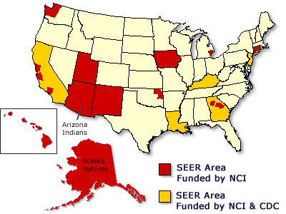
Surveillance Epidemiology and End Results Program (SEER)
Alaska Native Tumor Registry
Arizona Indians
Cherokee Nation
Connecticut
Detroit
Georgia Center for
Cancer Statistics
--Atlanta
--Greater Georgia
--Rural Georgia
Greater Bay Area Cancer Registry
--San Francisco
--Oakland
--San Jose
--Monterey
--Greater California
Hawaii
Iowa
Kentucky
Los Angeles
Louisiana
New Jersey
New Mexico
Seattle-Puget Sound
Utah
www.seer.cancer.gov
Notes:
SEER area are chosen because of their ability to provide high-quality incidence data and their population subgroups
SEER captures 31% of the US American Indian Population

Slide 18
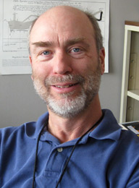
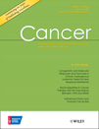
An Update on Cancer in American Indians and Alaska Natives 1999-2004
Cancer, Sept 1, 2008;11:5 (suppl) 1113-1274
Notes:
Luckily Dr David Espey, a CDC researcher loans to the IHS health promotion and disease prevention branch has championed methods to improve our data,
And I have been lucky to be able to come along for the ride

Slide 19
Racial Misclassification on Incidence Data
IHS Cancer Registry Linkage Project
Linkage study using data from
National Programs Cancer Registries (NPCR)
SEER Registries
IHS Linkages
If ever seen by an IHS/Tribal facility, considered AIAN
Cancer, September 2008
(Mortality supplement coming this Fall!!)
Notes:
In 2008 Dr Espey and a collaborative of over 30 authors published the results a an expansive project that looked at cancer incidence in AI and AN
We combined data from NPCE and SEER with IHS and tribal health records to better sort out WHO is indian,
We then focused on CHSDA areas were we knew the data would be the most accurate and published this data in the journal cancer
All available for free download

Slide 20
Regional Differences
Alaska
Northern Plains
Pacific
Coast
Data Capture
AK 100%
NP 59%
SP 64%
PC 56%
SW 88%
E 13%
Eastern
South West
Included
Excluded
Southern Plains
Notes:
For the analysis we broke the data down by region.
This graph shows the CHSDA counties as well as the regions which include
I would now like to share some of the finding for the top cancer in native people

Slide 21
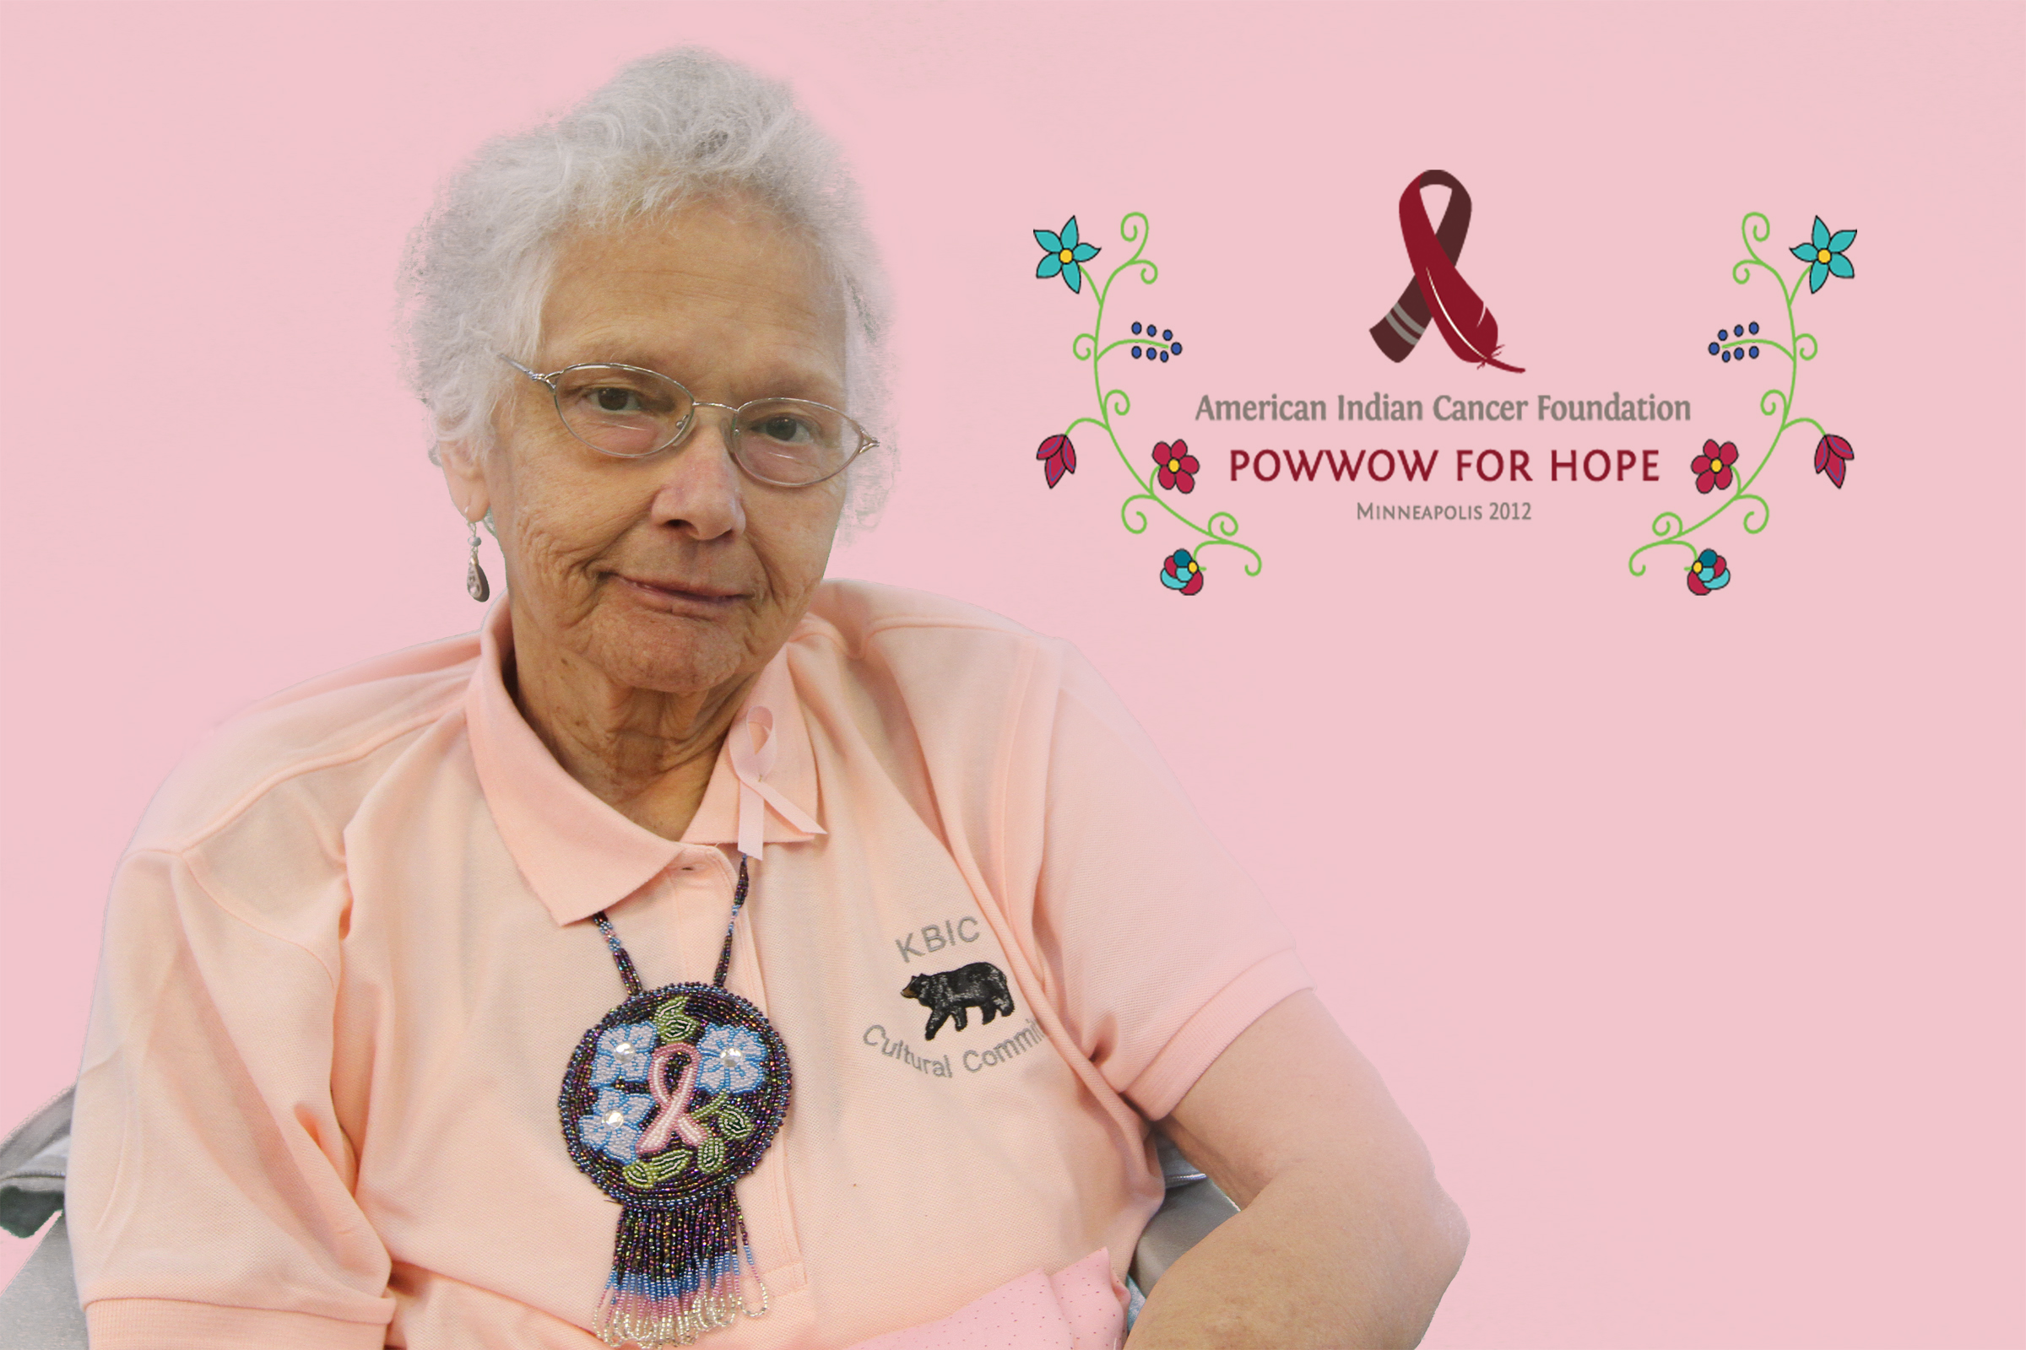
Breast Cancer
Notes:
Starting with breast cancer

Slide 22
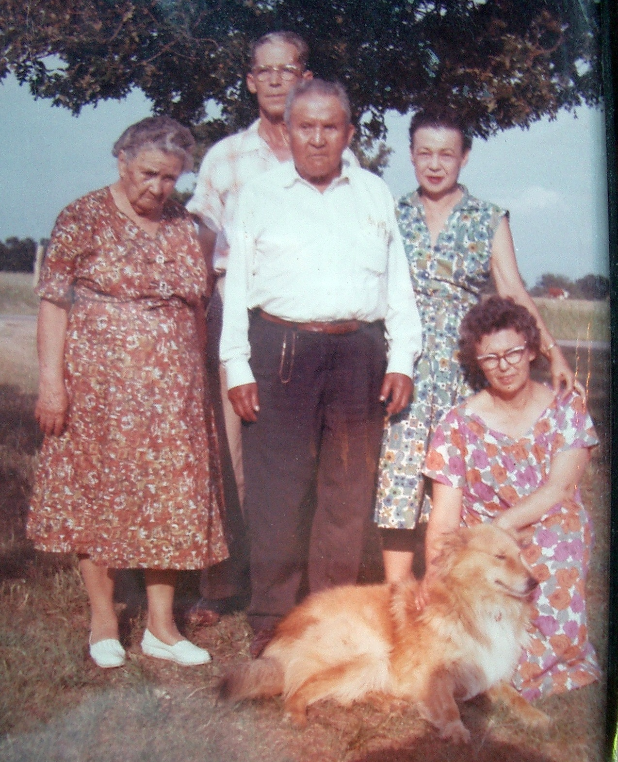

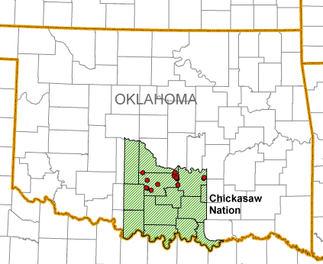
Notes:
Breast cancer is personal to me, as my Grandmother Lottie was a breast cancer survivor
This photo was taken by my father in 1962 of Lottie- neeling by the dog on her Chickasaw Nation land outside Winnewood Oklahoma
It also shows my Great Grandmother Nora and her brother Eisaw, both original enrollees of the Chickasa nation alsong wih my great Aunt Dee and Uncle Bill

Slide 23
BREAST CANCER INCIDENCE % difference vs NHW in same CHSDA counties (females only)
Cancer, 115:5 Suppl, Sept 2008
Notes:
Since I am focusing on disparities I am going to present the data in terms of percentage different compared to the Non Hispanic white living in the same CHSDA counties by region
Those regions are colored coded to the map in the upper left. These include::::
I will not report East Region as only 13% of East region AIAN are in he dataset
As you can see there are dramatic differences
Alaska native have a similar incidencof breast cancer
While southwest Indian have a rate that is 59% lower

Slide 24
BREAST CANCER AGE AT DIAGNOSIS
19% NHW cases are under age 50
31% AIAN cases are under age 50
Cancer, 115:5 Suppl, Sept 2008
Notes:
However, there are critical differences
31% of breast cancer in native women occurs before the age of 50 compared to only 19% of white cases
Ironically IHS GPRA measurs look at mammography in women age 52-64

Slide 25
Breast Cancer Late Stage at Diagnosis
Notes:
Furhermore, Native women are 5% more likely to be at late stage when they are diagnoses

Slide 26
Breast Cancer
Native Women have the lowest rate of breast cancer of all US ethnic/race groups
Native women also have the lowest survival rate of breast cancer once diagnosed
Notes:
The result?
While native women have the lowest breast cancer rate of all us race/ethnic group, they have the poorest survival

Slide 27
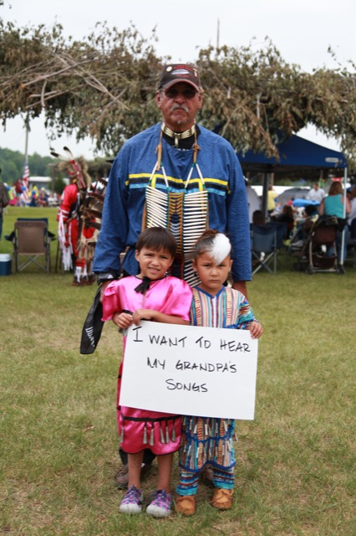
Prostate Cancer
Notes:
What about prostate cancer?

Slide 28
PROSTATE CANCER INCIDENCE % difference vs NHW in same CHSDA counties (males only)
Cancer, 115:5 Suppl, Sept 2008
Notes:
For reasons unknown, native men have much lower rates of prostate cancer, that is unless they live in the northern plains or southern plains where it is equal to white

Slide 29
Prostate Late Stage at Diagnosis
Late Stage: Regional or Distant Spread
Notes:
As for breast cancer, native men are more likley to be diagnosed at late stage disease. Prostate cancer has a relatively low mortality rate, UNLESS it is caught late!
5 year survival drops from nearly 100% for early stage to 29% with distant spread at diagnosis

Slide 30
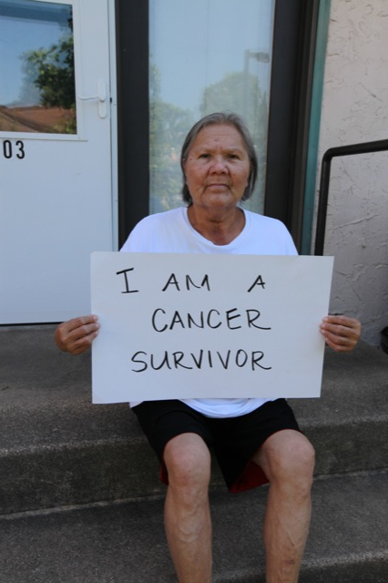
Lung Cancer
Notes:
What about lung cancer

Slide 31
LUNG CANCER INCIDENCE % difference vs NHW in same CHSDA counties
Cancer, 115:5 Suppl, Sept 2008
Notes:
Here is where we again see dramatic region variation with Northern Plains native have lung cancer rates almost 60% higher than white while rates in the southwest are 77% lower

Slide 32
LUNG CANCER AGE AT DIAGNOSIS
30% NHW cases are under age 65
41% AIAN cases are under age 65
Cancer, 115:5 Suppl, Sept 2008
Notes:
Across area, even in the southwest, lung cancer is more often developed at younger ages- with 41% of case being in those under 65, compared to 30% in NHWs

Slide 33
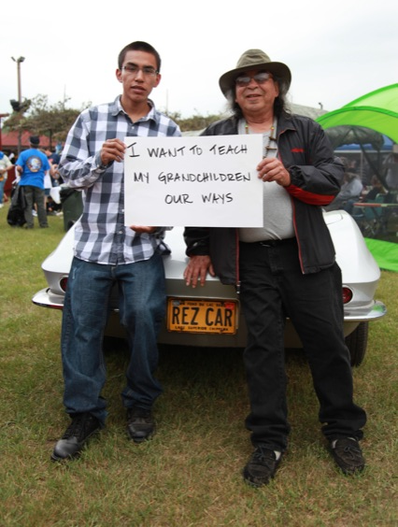
Liver Cancer

Slide 34
LIVER CANCER INCIDENCE % difference vs NHW in same CHSDA counties
Cancer, 115:5 Suppl, Sept 2008
Notes:
Liver cancer represents one of the largest disparities, driven by a high prevalence of cirrhosis. Cirrhosis comes primarily from alcoholic liver disease and chronic viral hepatitis.
The prevalence of chronic hepatitis B and C in many native communities is poorly known and a very simple questions to answer. Problematic to the question however is are there resources to treat it once found.
Alcoholic liver disease of course continues to be one of our biggest health challenges

Slide 35
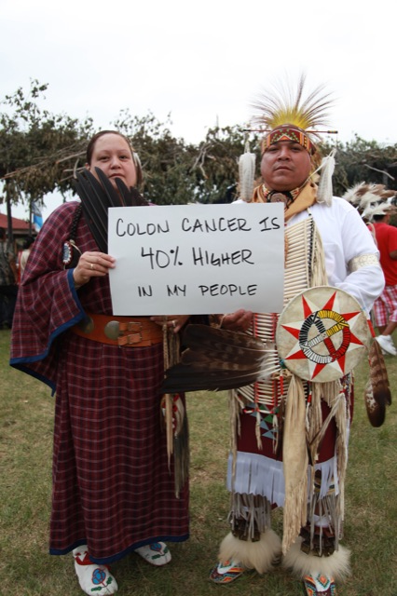
Colorectal Cancer
Notes:
As a gastroenterologist my special expertise in is in colorectal cancer

Slide 36
COLON CANCER INCIDENCE % difference vs NHW in same CHSDA counties
Notes:
This cancer also shows tremendous regional variation ranging from rates that are double that of whites in the Alaska, tohalf that of whites in the southwest
In the northern plains where I live it is 39% higher

Slide 37
Lifetime Risk
All Races | Males | Females
Any Cancer | 45% | 38%
Dying from Cancer | 23% | 20%
Breast Cancer | <1% | 12%
Prostate Cancer | 17%
Colon Cancer | 6% | 5%
Lung Cancer | 7% | 6%
Lung Cancer Smokers | 17% | 16%
US National Cancer Institute’s SEER Database, 2006 through 2008
Notes:
Many are surprised by their lifetime risk for cancer
These data are for the US polulation as good data for Native populations are lacking…..

Slide 38
Many Cancers: Many Challenges
Many types of cancer are higher in our communities
Almost all cancers are diagnosed in Native Men and Women at later stages where they are harder to treat and survive

Slide 39
Cancer Risk Factors

Slide 40
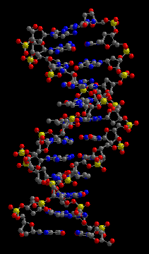
Approximate Lifetime Risk of Colon Cancer
Overall lifetime risk in U.S. | 5-6%
Parent or sibling with colon cancer | 12-18%
Two of the above with colon cancer | 18-24%
Parent or sibling with colon cancer before age 50 | 18-24%
Grandparent, Aunt or Uncle with colon cancer | 9%
Adapted from Winawer S, et al. Gastroenterology. 2003;124:544.
Notes:
Genetics plays a large role in many cancers from colon, to prostate to breast
A favorite quote of mine is that “Genetics loads the gun and the environment pulls the trigger”
Did you know your lifetime risk of colon cancer is1 in 17?
As shown that can jump to 1:4 in those with a 1st degree relative who developed CRC by age 50

Slide 41
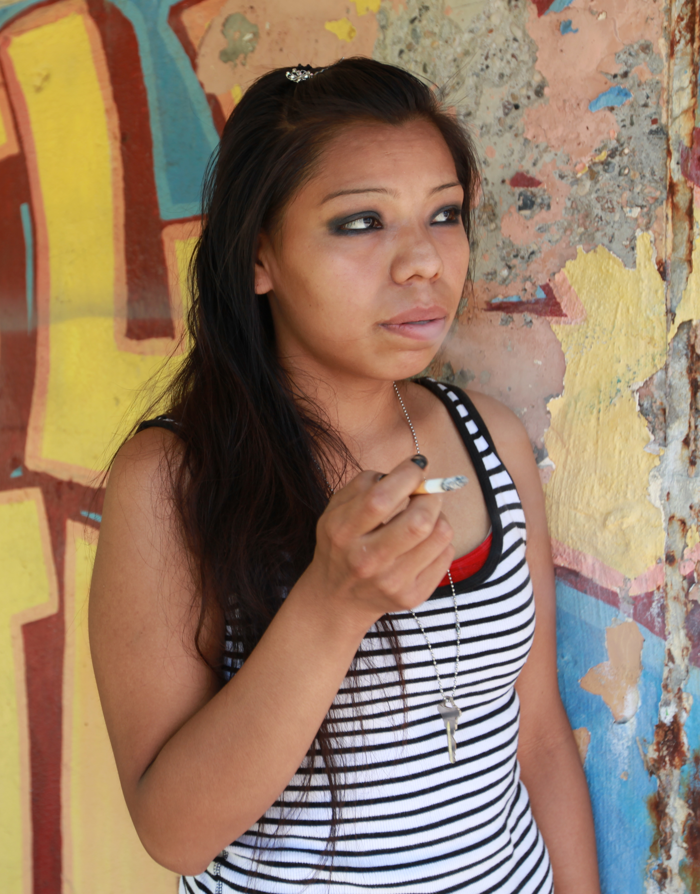
Risk Factors: Smoking
Cigarette smoke contains > 7000 chemicals including
Arsenic
Formaldehyde
Hydrogen cyanide
90% lung cancer cases occur in smokers and those exposed to second hand smoke
Notes:
Cigarette smoking is the second leading risk factor for cancer overall after genetics

Slide 42
LUNG CANCER INCIDENCE % difference vs NHW in same CHSDA counties
Cancer, 115:5 Suppl, Sept 2008
Notes:
Again, if we look at lung cancer rates they are higher than whites in AK and NO and they same in the Sp
However they ar lower in the PC and SW

Slide 43
Smoking Status BRFSS Data, 2000-2006
Cancer, 115:5 Suppl, Sept 2008
Notes:
Not surprisingly AK and the NP have the highest prevalence of current and former smokers while the SP rtes are a little higher
SW and PC have the lowest smoking rates and the lowest lung ca rates

Slide 44

Risk Factors: Second Hand Smoke
20-30% increased risk of lung disease
Responsible for >53,000 deaths in US per year
>3000 cases of lung cancer
Notes:
Second hand smoke is also deadly and increases you risk for lung disease up to 30%
It kilss 53000 americans per year from mostly cancer and heart disease and there are > 3000 lung cancer cases a year attributable to second hand smoke
This is a particular problem in Indian country where households tend to have more people and where we have 100,000 native working in non-smoke free casinos

Slide 45
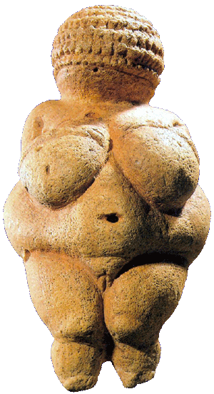
Cancer Risk Factors: Obesity
44% of Native adults are obese
70% are overweight
Ford ES. American Journal of Epidemiology 1999; 150(4):390-398.
Caan BJ, Coates AO, Slattery ML, et al. International Journal of Obesity and Related
Metabolic Disorders 1998; 22(2):178-184.
Kono S, Handa K, Kayabuchi H, et al. Japanese Journal of Cancer Research 1999; 90(8):805-811.
Shike M. American Journal of Clinical Nutrition 1996; 63(3 Suppl):442S-444S.
Notes:
Obesity is

Slide 46
Obesity Increases the Risk for Multiple Cancers
Esophagus
Pancreas
Colon and rectal
Breast
Endometrium
Kidney
Thyroid
Gallbladder

Slide 47
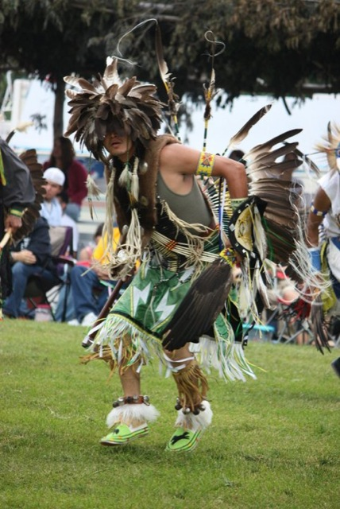
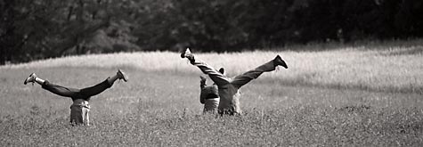
Physical Activity
Regular physically active can reduce the risk of developing cancer by 40 to 50%
Wu AH, Paganini-Hill A, Ross RK, Br J Cancer 1987;55:687-694.
Levi F, Pasche C, Lucchini F, et al J Cancer Prev 1999;8:487-493.
Tang R, Wang JY, Lo SK, Hsieh LL. Int J Cancer 1999;82:484-489
Notes:
Data less convincing for women
Highly active have the lowest risk

Slide 48

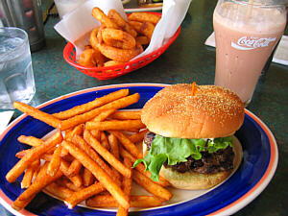
CRC Risk Factors: Diet
High in animal fats
Low in fiber
Low in fresh fruits and vegetables
Notes:
Cruciferous Vegetables such as Broccoli, Brussel sprouts Cabbage and Cauliflower release phenethyl-ITC- a substance thought to induce apoptosis in cancer cells and may decrease the risk of both colon and lung cancer.

Slide 49
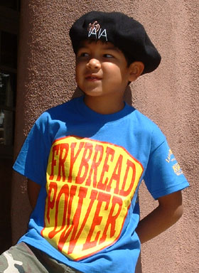
Commodity Foods:
Canned Beef
Canned Chicken
Canned Pork
Beef Stew
American Cheese
Processed Cheese
Evaporated Milk
Dehydrated Potatoes
Pudding
Canned Mixed Vegetables
Macaroni and Cheese
USDA Commodity Supplemental Food Program: http://www.fns.usda.gov/fdd/programs/csfp/
Notes:
Cruciferous Vegetables such as Broccoli, Brussel sprouts Cabbage and Cauliflower release phenethyl-ITC- a substance thought to induce apoptosis in cancer cells and may decrease the risk of both colon and lung cancer. Historically fresh produce has been a rare commodity on Indian reservations, and are often underconsumed by the socioecomically disadvantaged. Low income Indians families have received commodity foods from the federal govt since the late 1960s-- All received foods are canned, many are very high in fat, and none of the vegatables are cruciferous

Slide 50
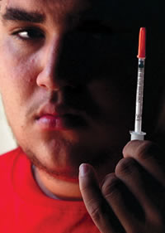
Risk Factors: Diabetes
Diabetes doubles risk of
Liver Cancer
Pancreatic Cancer
Endometrial Cancer
Increases risk by 20-50%
Colon Cancer
Breast Cancer
Bladder Cancer
30% of AI/AN over age 55 have diabetes
Larsson SC et al JNCI 2005;97:22: 1679-87

Slide 51
There are many other risk factors for different types of cancers
Environmental
Occupational exposures
Radon
Nuclear
Sun over-exposure
For several cancers underuse of screening is a major risk factor!

Slide 52

SCREENING IS THE LOW HANGING FRUIT!
Notes:
Screening is the low hanging fruit for improving colon cancer and breast cancer survival

Slide 53
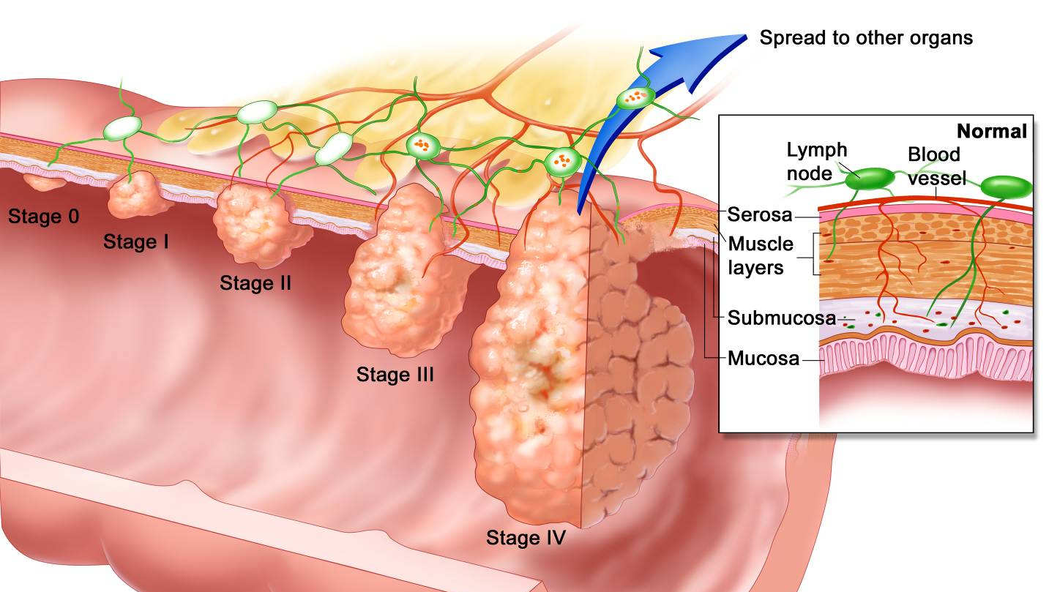
Colon Cancer
Notes:
This slide show how colon cancer is staged….
(explain)
This is critical as stage is directly related to survival

Slide 54
Five-Year Survival Rates (%)
Survival rate (%)
Stage
I and II
Stage
III
Local spreading
Stage IV
Distant spreading
Regional
Stage at Diagnosis
Adapted from American Cancer Society.
Colorectal Cancer Facts & Figures Special Edition 2005. Atlanta: American Cancer Society, 2005.
Notes:
While 90% of individuals with cancer limited to the bowel wall are still alive 5 yrs after diagnosis, tdecrease to 67% with regional spread and plummets to 10% for metastatic disease

Slide 55
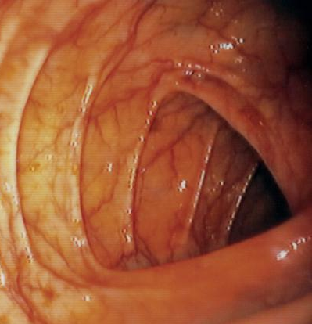
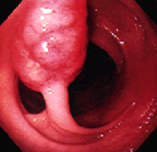
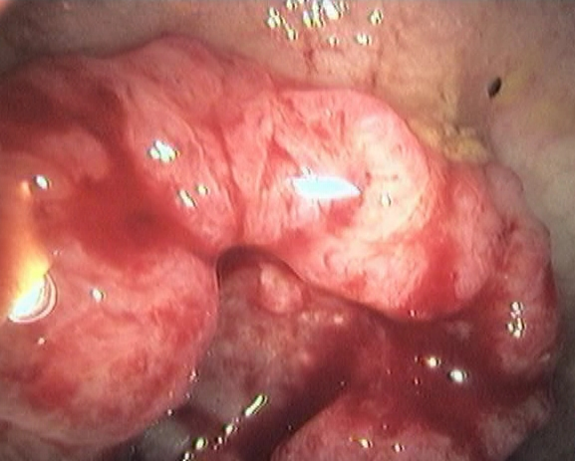
More than 95% of Colorectal Cancers Start Out as Polyps
Normal Colon
Polyp
Colon Cancer
Removing polyps decreases colon cancer risk by as much as 90%
Notes:
Screening can not only decrease mortality by catchin cancer early when it is easier to treat, but can prevent the disease as well.
90% of colon cancer start out as polyps. If we remove the polyps we drmatically reduce the risk of colon cancer

Slide 56
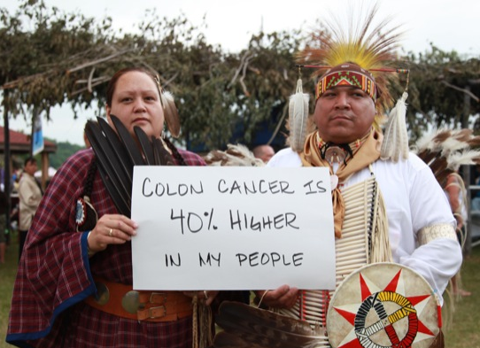
Colorectal Cancer Screening Works
EARLY DETECTION
INCREASE SURVIVAL
POLYP REMOVAL
DECREASE CANCER RISK UP TO 90%
Notes:
So – catch it early, improve survival
Take polyps out- decrease cancer risk by up to 90%

Slide 57
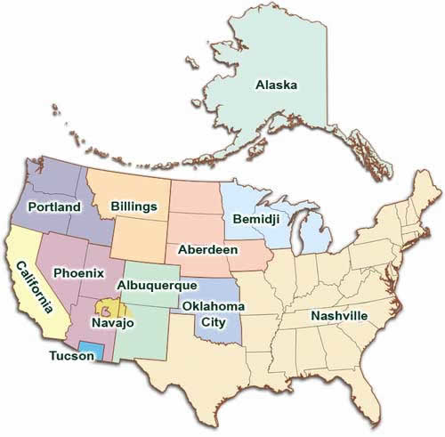
%
*US All Races: 2010 BRFSS Data,
MMWR, July 8, 2011
Notes:
However, GPRA screening rates for Naïve men and women are significantly lower than for all us races combined,
2011 GPRA rates ranged from a low of just 14% in Tucson are to as high as 59% in AK- we will come back to thi but I want you to think about the challnges of screening in AK and the fact that they do not use stool tests.

Slide 58
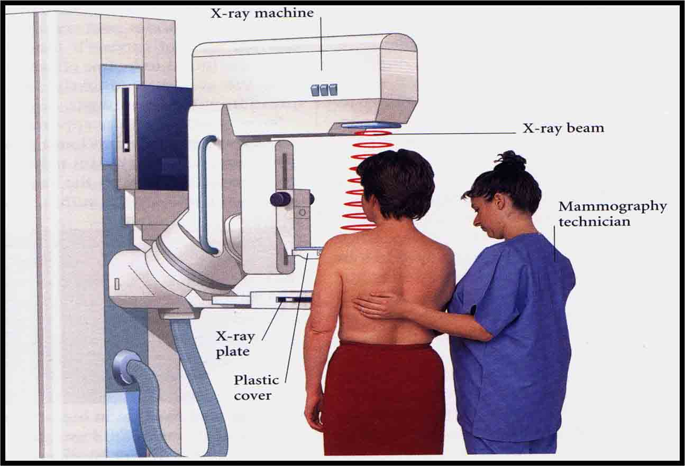
Programmatic Breast Cancer Screening
Reduces mortality by 16% in women over 40
Reduces mortality up to 30% in women over 50
Notes:
Breast cancer screening also reduces mortality, but does not affect incidence.
Programatic screening reduces mortality 16% in women over 40, and up to 30% if we focus on those over 50

Slide 59
%
*White Women Age 50-64,
2008 National Center for Health Statistics
Notes:
31% diagnosed age 50 and younger

Slide 60
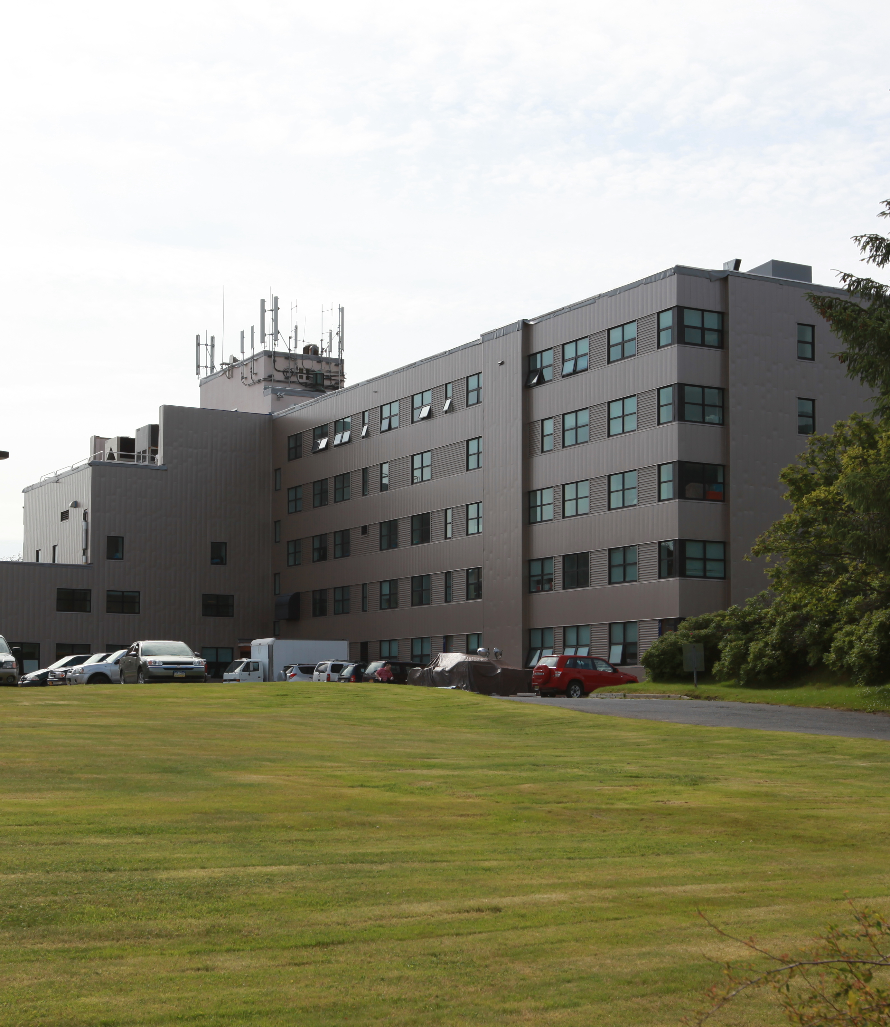
Health System Challenges
Underfunding
Provider shortages
Acute care focus
Competing health priorities
Rationed healthcare
Poor access to specialists and screening procedures
Long distances to travel
Notes:
So why are our screening rates lagging so far behind in many areas?
Well we have

Slide 61

Provider Challenges
To little time to discuss screening
Competing priorities
Cultural/language barriers
Confusing screening algorithms
Knowledge Gaps
Notes:
We have provider challenges:

Slide 62
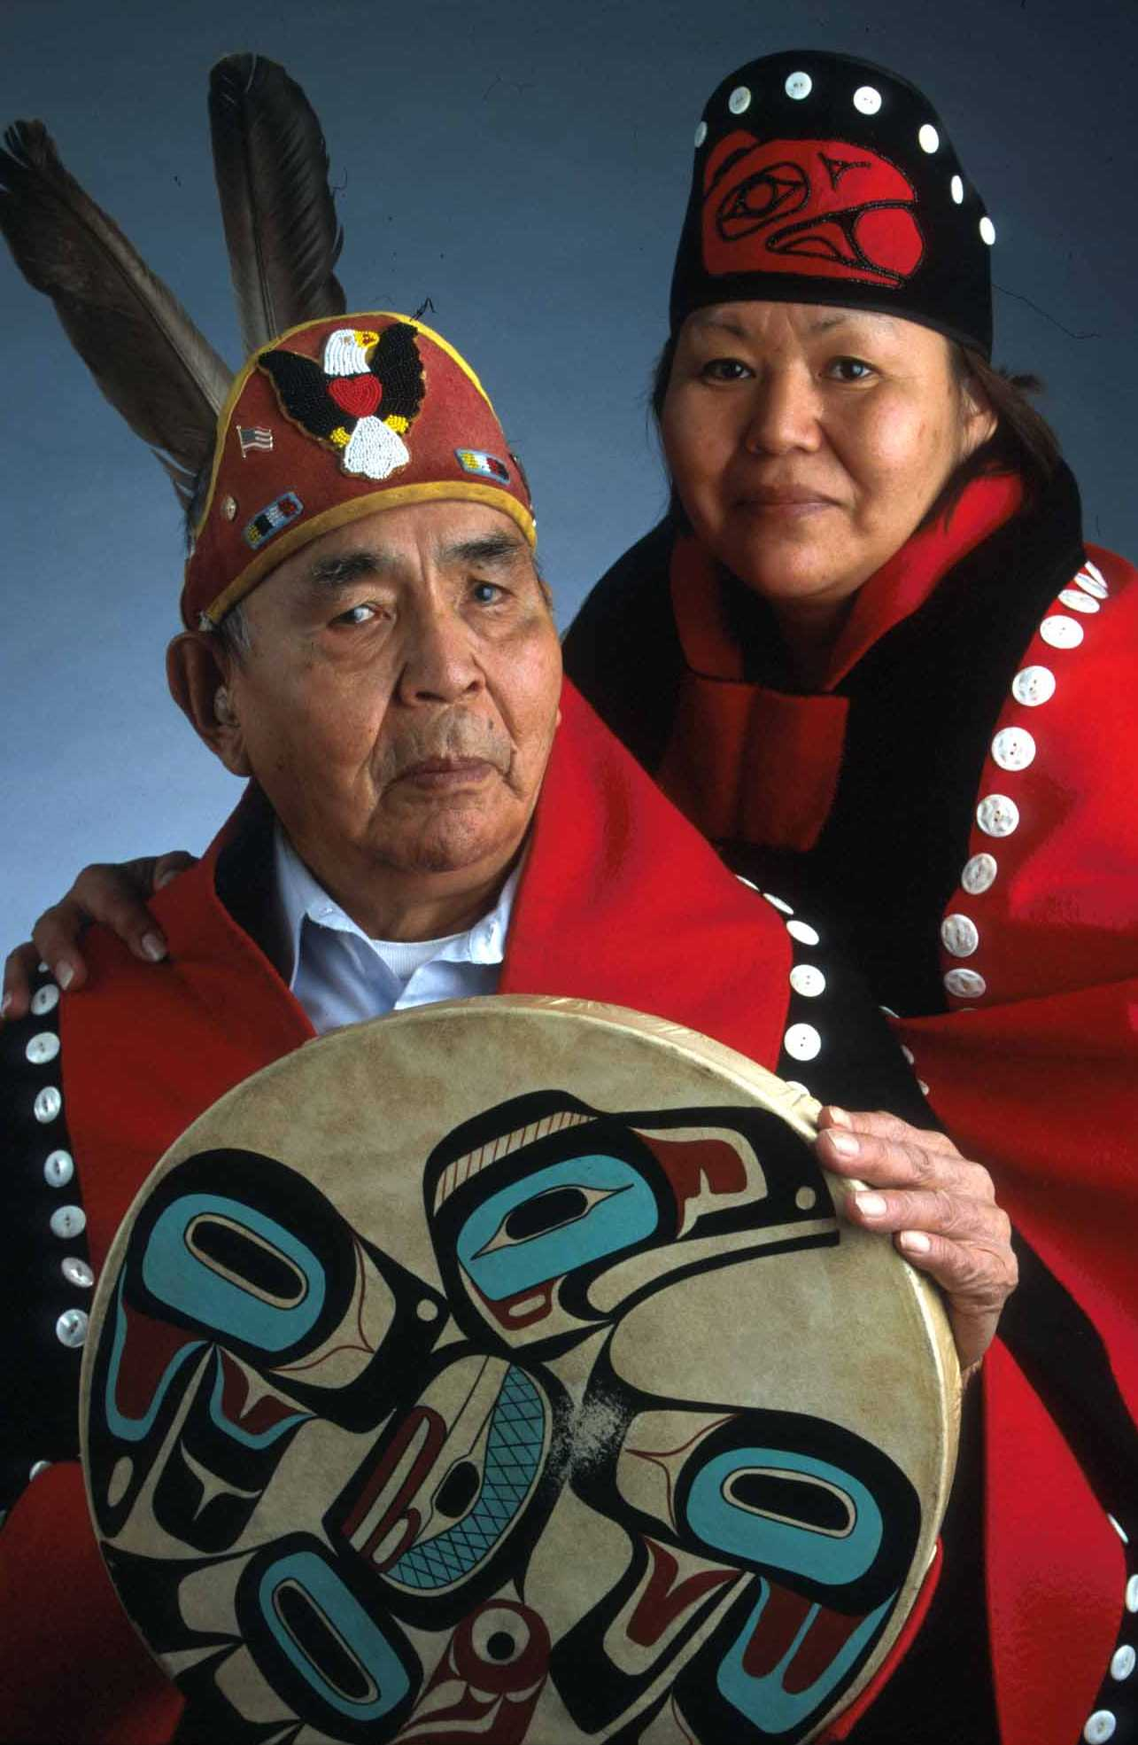
Community Challenges
Low health knowledge
Poor access to information
Social dissuasion
Fiscal uncertainty
Language barriers
Mistrust of Western Medicine

Slide 63

And along will come a spider…
SOLUTIONS
Asabikeshiinh Akoziwin
Notes:
Two weeks ago I was struggling for a catchy title for this presentation. The following weekend I was honored to be asked to present on colorectal cancer at the Minnesota Annual Gathering of Traditional Healers here in Minneapolis. While there I had the opportunity to have lunch with a group of 12 spiritual leaders and traditional healers, mostly from the Norther Minnesota reservations, to discuss ways in which I might collaborate with them to begin to address the colorectal cancer disparities experienced by American Indian communities in our state.
It was here that a respected spiritual leader and healer went on to tell me about a dream he had had when he was younger. He had dreamt of a spider that came along and began to terrorize his community, and that despite his healing powers, could not be handled by traditional ways. By the end of his dream it became apparent to him that only by working with white men could the suffering caused by the spider end. He went on to explain that for many healers, visions portending cancer often come in the form of a spiderweb cast upon the patient’s body. It was his interpretation that the spider in his dream symbolized cancer, and that our meeting that day was to begin to work together to fight this spider.

Slide 64
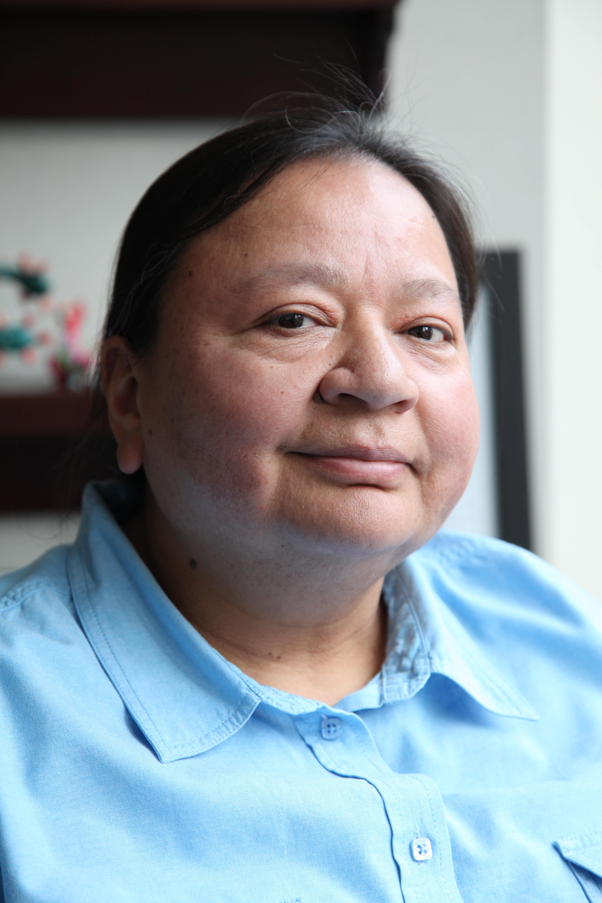
What Can We As Sovereign Nations About Our Cancer Epidemic?

Slide 65
Critical Steps
Find resources to address cancer disparities
Special Cancer Program for Indians??
Discern or own research questions
Invest in tribal health research programs
Know what our most pressing problems and questions are
Partner to discover tribally-specific solutions
Embrace the Community-Based Participatory Model

Slide 66
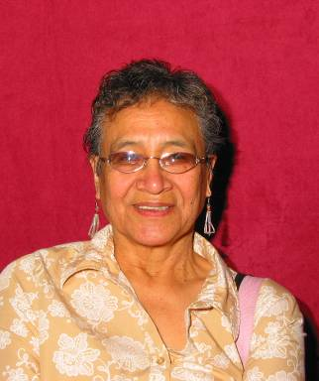
Critical Steps
Engage our Communities
Elder to elder education
Elder to child education
Community think-tanks
Survivor support programs
Navigator Programs
Incentivize healthy behavior
What gets rewarded gets done

Slide 67
Critical Steps
Improve our tribal health cancer screening
Provider education
Provider reminder systems
Improve screening and result tracking systems
Patient reminders
Improve access to screening

Slide 68
Critical Steps
We must move to make all of our casino’s smoke free!
For the health of our casino employees
For the health of our casino patrons
We must work to gather more data to debunk the idea that it will hurt revenues
Notes:
We must work towards smokefree casinos! This is a talk in itself but there are no sound arguments against it, just misconceptions.
Gamblers come to gamble, not to smoke
Non-smokers avoid gaming or stay for shorter amounts of time
Many avoid even coming for non-gaming events
Air handlers and scenting are ineffective

Slide 69
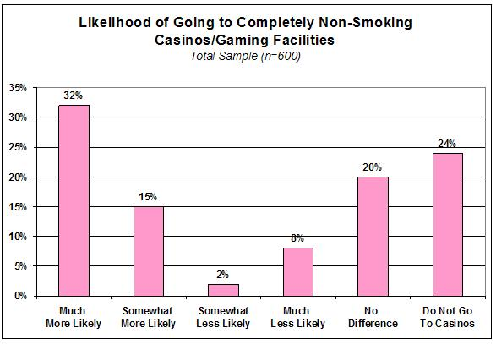
Patrons prefer non-smoking environments
Notes:
A study of 600 New Mexico residents found only 8% of respondent would be somewhat or very much less likley to go to a smoke free casino, while 32% would be much more likley.

Slide 70
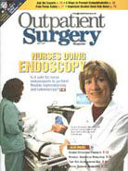
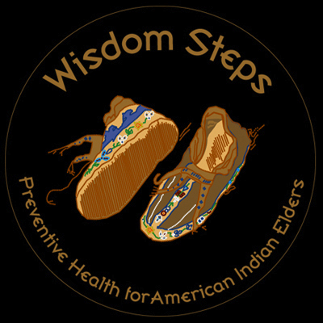
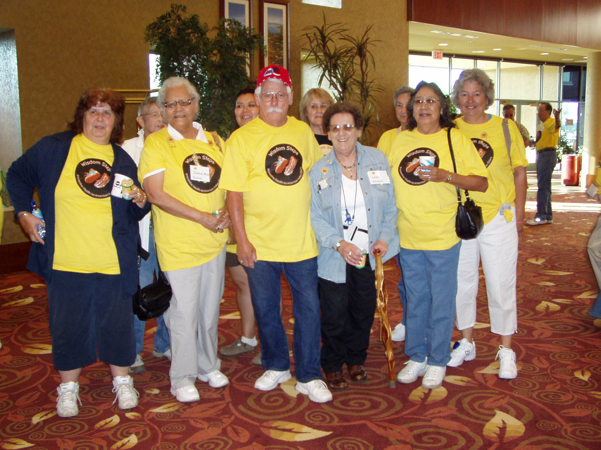
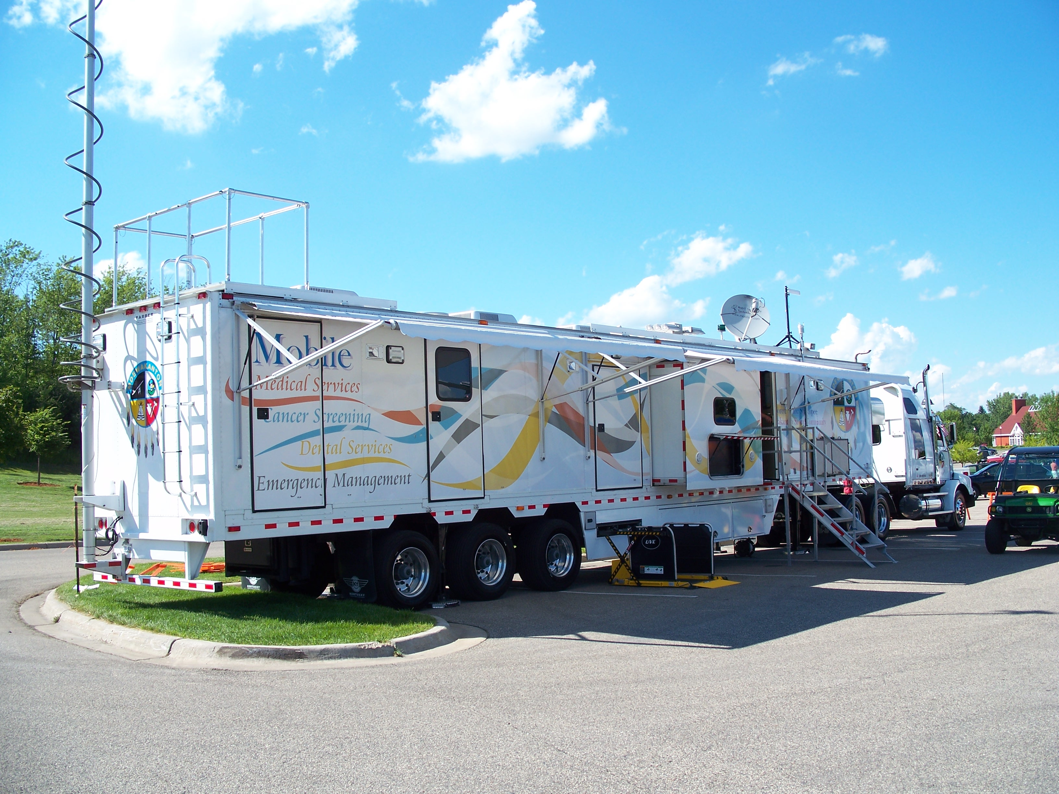
Examples of Success
Notes:
I think it is critical to point out successes

Slide 71
Wisdom Steps
Elder health program started in Minnesota in 2002
Participation by all tribes in Minnesota
Mission: Improve elder health
Uses incentives and education to encourage health behaviors
Notes:
Wisdom steps is one of these successes
This program was started in 2002 as a collaboration between the Minnesota Board on Aging and Minnesota tribes
Has grown to include several thousand participants representing all Minnesota tribes
Its mission is to improve elder health.
Incentives and ed are used to encourage health behaviors

Slide 72
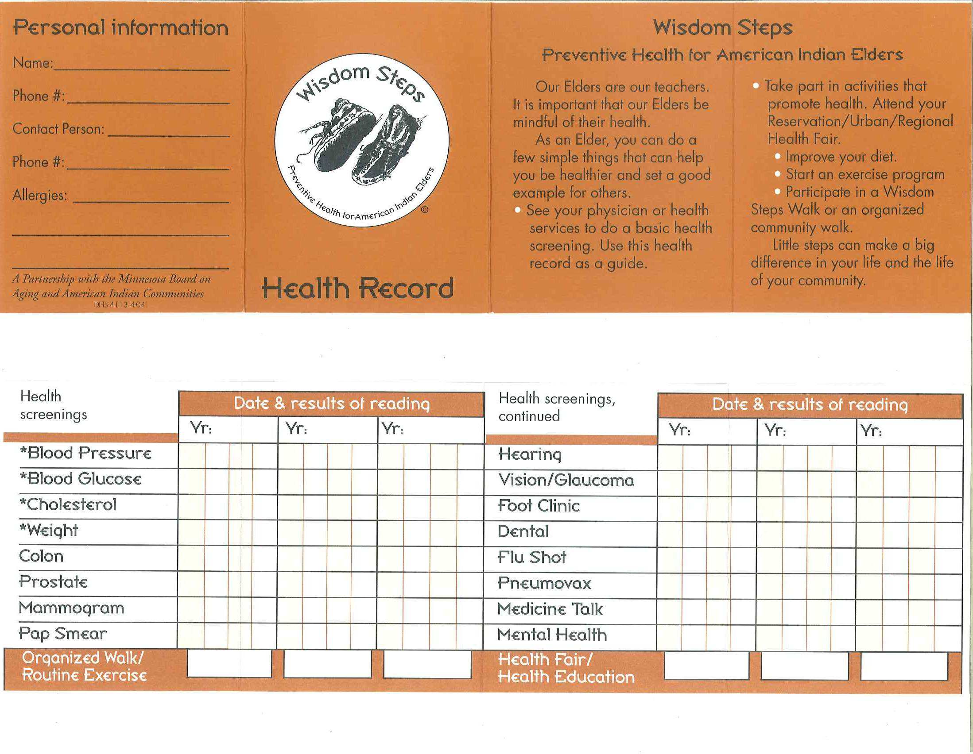
Wisdom Steps
Notes:
This is an example of the card particiapants receive
There are challenged to complete at least 5 health screenings per year and either due organized walks or routine exercise and attend health fairs and other education events

Slide 73
Wisdom Steps
Completion of at least 5 screenings plus one behavior: earns
A charm or pin
A certificate
Entry to the annual awards dinner and conference
Notes:
Completion earns several incentives including>>>

Slide 74
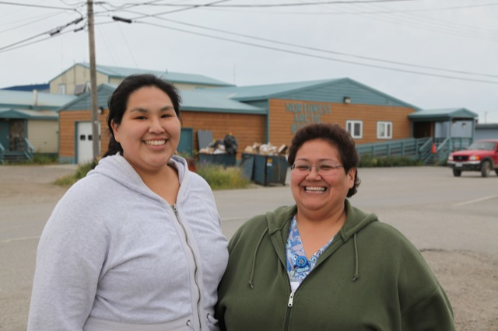
The Alaska Example
Notes:
AK is another example of what can happen when Native resources are devoted to Native problems

Slide 75
Age-Adjusted Invasive Colorectal Cancer Incidence by Region,1999-2004 AI/AN vs Non-Hispanic Whites in CHSDA Counties
Notes:
As I showed before, Ak has the highest crc rate of all IHS regions,

Slide 76
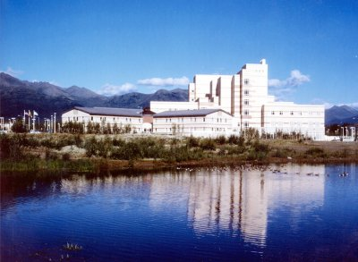
Alaska’s Proactive Approach
Nurse Practitioner performing colonoscopy at ANMC
Mid-levels conducting flexible sigmoidoscopy at regional centers
Traveling endoscopists
Extensive population education, DVDs, brochures, community health workers
Resources
Notes:
Claudia
However, they have been the most proactice of all regions in addressng this disparity with the following

Slide 77

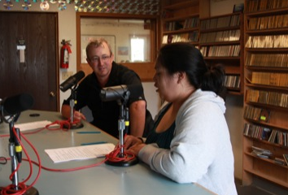
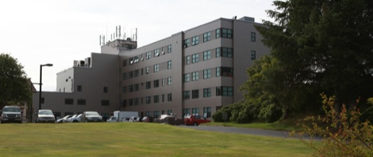



Notes:
Provider education has also been a key component and I ws fortunate to be sponsored by the AK tribal health consortium and the Southcentral foindation to undergo a speaking tour to Kotzebue, Sitka and Anchorage where I did provider education, and two public radio interviews on CRC

Slide 78

Colorectal Cancer Incidence Trends, Alaska Native People
Notes:
These efforts are paying off as you can see by their CR incidence trends over the last 18 years

Slide 79
Shakopee Mdewakanton Mobile Unit
Multi-use vehicle
Mammograms
Dental
Health screening
Disaster Response
>4000 Mammograms
Free if no insurance
Notes:
Lastly, the Shakopee Mdewakanton Sioux Community is another example of Native resources serving native health. Their mobile unit has been deploying across Minnesota and into
neighoring states for 7 years and have provided over 4000 mammograms on reservations.
Tell story of Mille Lacs

Slide 80
Innovation
Community Engagement
Pooled Resources
Expertise
Wisdom
Culturally tailored approaches
Notes:
Innovation, community engagement, pooled resources, expertise, and wisdom are the ingredient for decreasing cancer in our communities. That’s our Founding Board started the American Indian Cancer Foundation

Slide 81

Mission:
To reduce cancer and its impact on all American Indian and Alaska Native families through: community-based participatory research, education, and improved access to prevention, early detection, treatment and survivor support.
Notes:
AICAF is a 501 c3 located in Minneapolis Minnesota
Our Mission

Slide 82

AICAF’s Core Values
C OMMUNITY-CENTERED
R ESPECTFUL OF TRADITION
A DVANCING KNOWLEDGE
N ATIVE DIRECTED
E MPOWERING
Qucillgaq: Yup’ik Spirit Crane
Philip John “Arnaquq” Charette

Slide 83






Board of Directors and Key Personnel
Jo Anne Stately
Anishanabe
Chair
James Lien
Sicangu Lakota
Treasurer
Joanna Bryant
Shakopee-
Mdewakanton
Vice-Chair
Jackie Dionne
Turtle Mountain
Secretary
Laura Waterman-
Wittstock
Seneca Nation
Communications
Jessica Ryan
Brotherton
Attorney
Notes:
We have a 100% Native Board and 100% of our employees are Native also

Slide 84






Board of Directors and Key Personnel
Mike Goze
Ho-Chunk
Member
Howard Valandra
Sicangu Lakota
Member
Kris Rhodes
Fond du Lac
Executive Director
Mike Snesrud
Shakopee-
Mdewakanton
Member
Anne Walaszek
White Earth
Research Analyst
David Perdue
Chickasaw
Medical Director
Notes:
We started with a local board of Native professionals and are in the process of expanding our board for more national representation

Slide 85

AICAF Believes Its Time to Eliminate or Cancer Disparities
To educate our people
To work to reduce risk factors
To improve access to healthy food
To embrace our sovereignty and find our own solutions
Notes:
Aicaf believes its time for us to suceed

Slide 86

Our Approach
Partner with tribes and tribal health systems
CBPR
Provide organizational capacity and expert input
Assist in finding community-specific solutions
Facilitate pooling of resources

Slide 87
Steps To Eliminate Cancer Disparities
1) Understand and Earn the Trust of the Community
2) Attain Good Data
3) Base Work on the Health Belief Model
Best derived with the population’s participation
Understand the barriers
4) Use model to identify interventions
5) Help the community to help themselves
6) Listen to the elders and think outside the academic box!

Slide 88


Slide 89
Our Work Will Succeed!
Our Current Projects:

Slide 90



Minnesota Intertribal Cancer Council
Minnesota Intertribal Colorectal Cancer Council
Notes:
One example of our CBPR efforts is the MICCC
This group of health workers from tribes across Minnesota, AIcF, the Minn dept of health and the U of MN nd Mayo clinic meet regularly to address cancer disparties
In 2007 we held the first Native Dialogu for action on colon cancer

Slide 91

What are the barriers to screening in our communities?
Cost and un- or underinsurance
Transportation
Distance to services
Fear of western medical facilities
Modesty, embarrassment
Idea that cancer is a “death sentence”
Lack of education about benefits of screening
Notes:
At this statewide event we asked a lot of questions. We aked….

Slide 92

What is needed in our communities to increase screening?
Elders are afraid of large hospitals and city clinics. “ We need the services here”
Indian-specific programs that work with our communities, not just try to tell us what to do
Better systems in our clinics to track who needs screening
Resources to pay for screening
Native health workers who can talk to us about the importance of screening respecting our ways
Notes:
We asked…
Using this information we went to work

Slide 93
MICCC’S Success So Far
First Intertribal Dialogue for Action
5 tribes adopted resolutions making screening a priority
Survey of elders on CRC screening knowledge, attitudes and beliefs
Focus Groups on barriers
Native-specific education materials
Spawned local cancer teams
Minnesota Intertribal Colorectal Cancer Council

Slide 94

Culturally-Specific Education

Slide 95

INPACS: Improving Northern Plains American Indian Cancer Screening
54 Northern Plains ITUs
Assess Colon Cancer Screening
Tracking systems
Referral Systems
Cost
Assess Provider Screening Knowledge
Endoscopic Capacity Study

Slide 96

Improve Provider Recommendation!
Having a provider who recommends screening is the STRONGEST predictor of screening
INPACS provides a CME course for providers at all 54 sites we are engaging

Slide 97

Cancer Screening Navigation
Cancer Navigator
Grants to assess telephone navigation
Community partnerships with urban Indian clinics
Plan to expand to reservation health systems

Slide 98

Smoking Programs
Conducting a program to assess smoking cessation resources and use at I/T/Us
Improve clinic efforts to engage smokers to quit
Urging for smoke free casinos

Slide 99

Cancer Survivors Project
AICAF is currently filming cancer survivors talking about their experiences and fears
Notes:
This an example of elder to elder education

Slide 100

Powwow For Hope
AICAF held its first Powwow for Hope in Minneapolis in April 2012
2000 attendees
25 teams
Survivors Dance
Hope to have similar events across the country
Fundraiser for AICAF and tribal health programs

Slide 101


Slide 102


Slide 103


Slide 104

We have BIGGER Ideas

Slide 105
We Need More Data to Inform Policy
Questions Need to Be Answered:
Should
Colorectal cancer screening start earlier?
Breast cancer screening start earlier?
What is the risk/benefit of lung cancer screening in high risk regions?
Are GPRA measures appropriate?
Why are Southwest Cancer rates so low?
Notes:
We know we need to improve what is known about best practices for cancer prevention and control in indian country

Slide 106


Improving Access to Screening
AICAF aims to develop partners and funding sources and partnerships to launch a mobile colorectal cancer screening program that could provide as many as 3,000 colonoscopies per year

Slide 107




Slide 108


Mobile Education
Interactive Multimedia Cancer Education
Schools
Health Fairs
Community Events

Slide 109


Access to 21st Century Treatments
Cultural Literacy Programs
Hospital Accreditation Program
Medical School Student Education
Telemedicine
Itinerant providers
On-site chemo

Slide 110



Spirit Lodges
Long-term lodging near major cancer centers that meet the needs of Native cancer patients

Slide 111
How you can help
Get to know us
Facebook
Twitter
AmericanIndianCancer.Org
PowwowForHope.Org
Help others to know us
Tribal health directors
Tribal Council
National Organizations

Slide 112
Summary
Cancer rates vary by region
Age of onset is often younger and stage of disease more advanced
Screening is the low hanging fruit
Community-based solutions are key
We can end our cancer inequities

Slide 113
Join us on the path to success

